Slide 1
Lab. 10
Logic Design Lab.
Spring 2014
Prof. Naehyuck Chang
(naehyuck@snu.ac.kr)
TA. Taeyoung Kim
(tykim@iris.snu.ac.kr)
TA. Duseok Kang
(kangds0829@iris.snu.ac.kr)

Slide 2
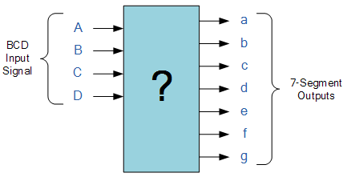
Practice (result report) - Xilinx
Implement BCD to 7-segment decoder

Slide 3

Practice (result report) - Xilinx
Implement a 5-input, one cathode 7-segment display output logic as below using 16:1 MUX and any other logic gates we have learned in previous lectures
Input
- Two 2-bit binary inputs (00,01,10,11), One 1-bit selector input
Output (7 segment display)
Case1 (when adder is selected) :
- “A1A0 + B1B0” result in 7 segment decimal output (“0” ~ “6”)
Case 2 (when comparator is selected) :
- If A1A0 >= B1B0, then 7 segment decimal output “1”
- If A1A0 < B1B0, then 7 segment decimal output “0”
Write result report (10th) about today’s practice. Maximum 3 pages. (Due : April, 14th)
A1
A0
B1
B0
S
?

